Slide 1
Asset Liability Management System
Team Members: Harsheet Sharma, Amitesh Sharma, Yugant Vashishtha, Ayushi Bathla, Mohd. Arkam
Date: 25th July, 2025
Batch Details : Batch-3

Slide 2
Problem Statement
Our ALM System simplifies managing an organization's financial assets and liabilities. It tracks key details like Assets, Liabilities, Branches, Departments, and Employees to ensure smooth operations. Think easy asset assignment, liability monitoring, and transfer logging. We've built in data integrity, audit trails, and handy metrics like net asset value for clear insights and control.

Slide 3
Objective
Maintain Financial Stability: Balance assets and liabilities to ensure smooth operations and avoid mismatches.
Manage Risk Effectively: Identify and control risks like interest rate, liquidity, and credit risks.
Support Better Decisions: Use scenario analysis and real-time data to make informed financial decisions.
Ensure Compliance: Keep proper records and audit trails to meet regulatory requirements.

Slide 4



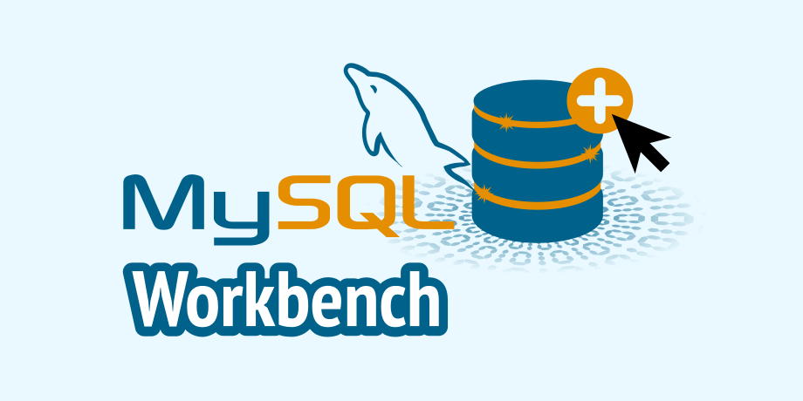



Tools & Technologies

Slide 5
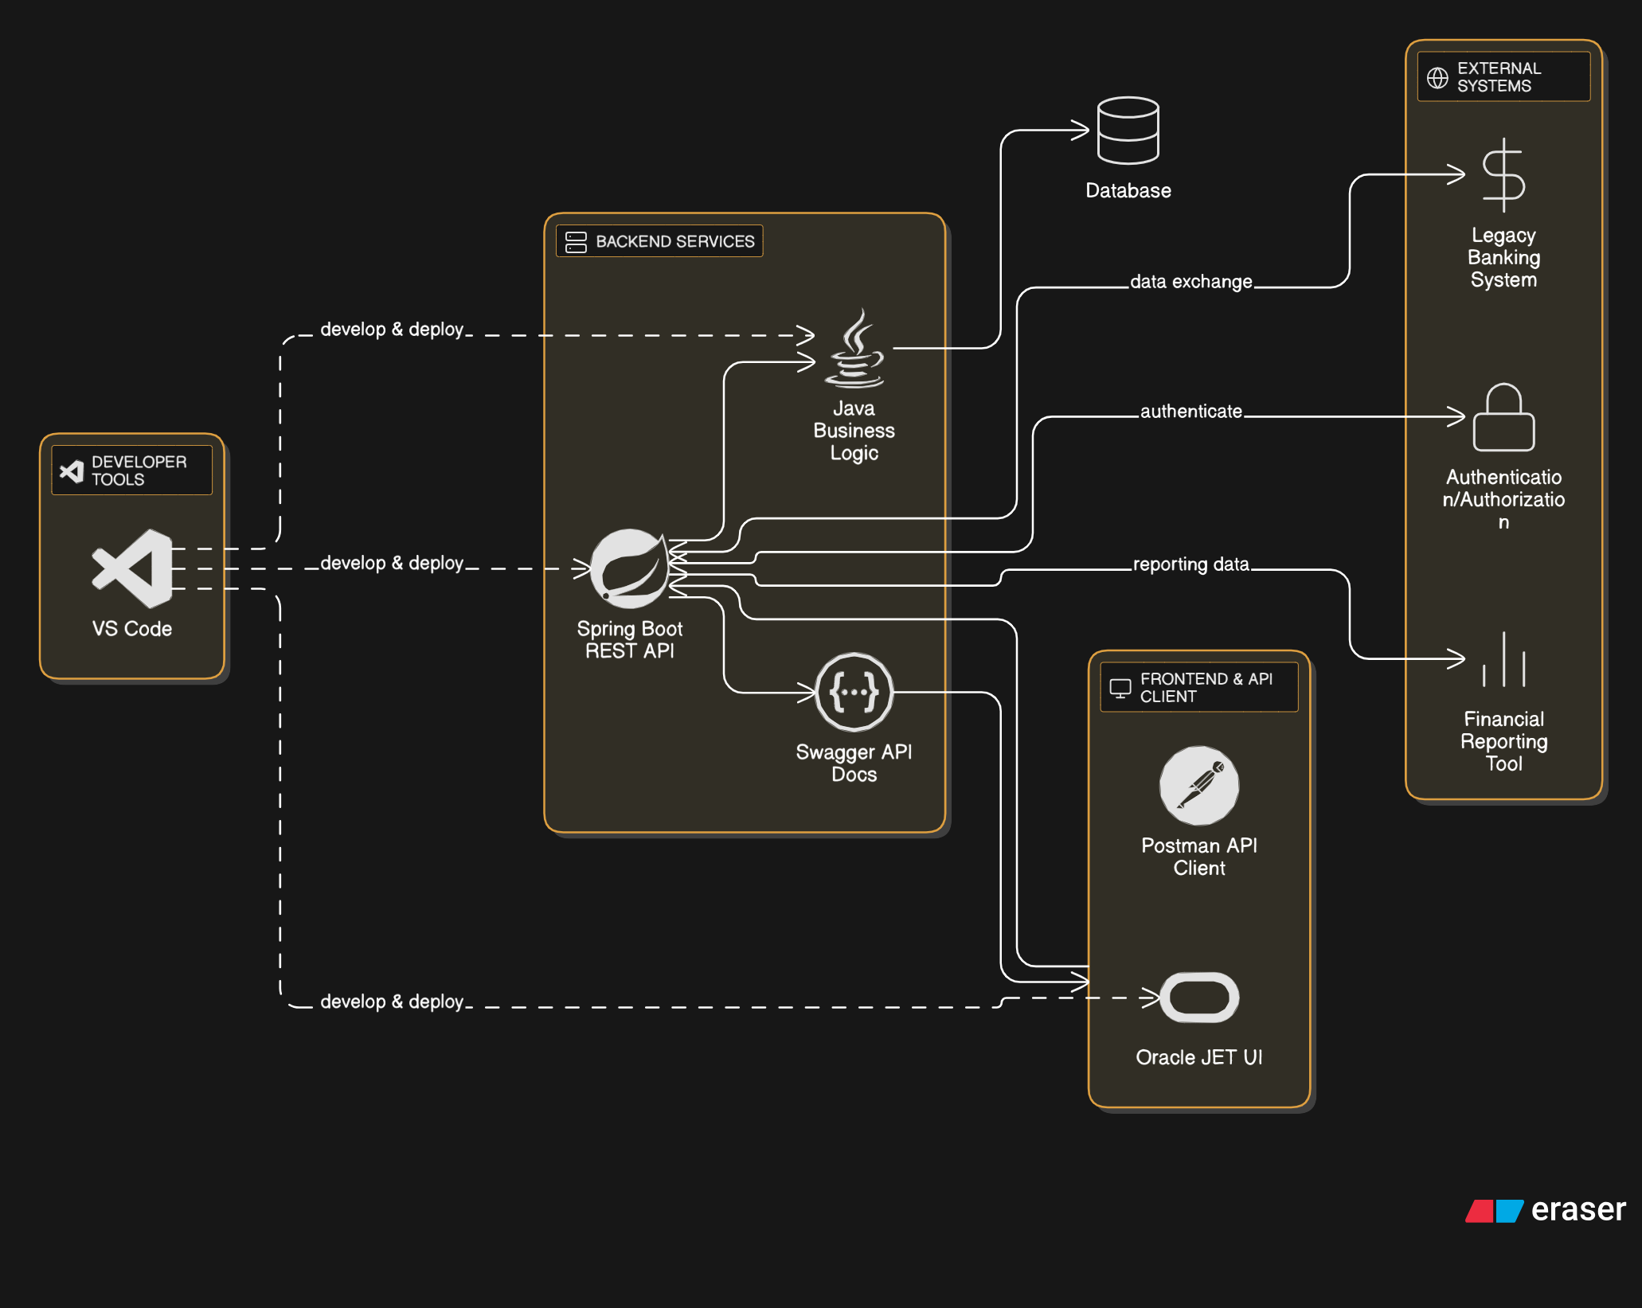
High-level Architecture

Slide 6
Key Components/ Features
Secure Access: Our system features secure login and role-based access, ensuring only authorized users can view or change sensitive data.
Dynamic Frontend (Oracle JET): We've built an interactive user interface with Oracle JET, allowing for real-time data display, filtering, and seamless user interaction.
API Layer (Spring + Swagger): All modules are accessible via REST APIs, clearly documented with Swagger UI for smooth frontend-backend communication and testing.
Real-Time Dashboard & Reporting: Get instant insights with our dashboard and reports, perfect for financial analysis and quick decisions.

Slide 7
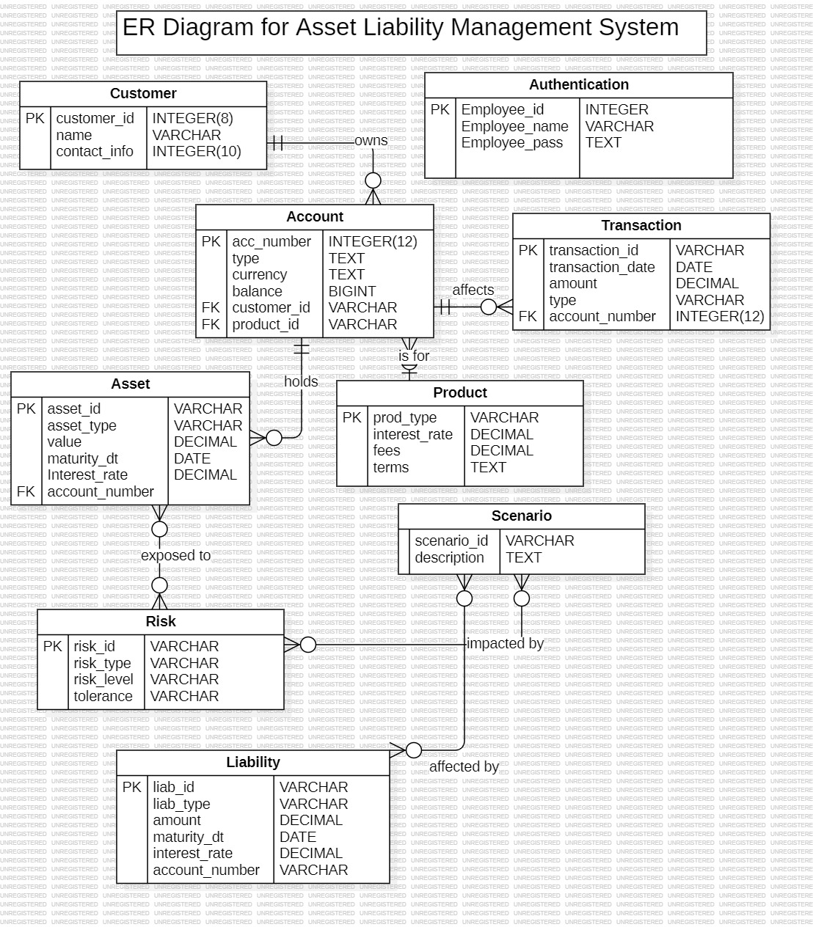
ER Diagram

Slide 8
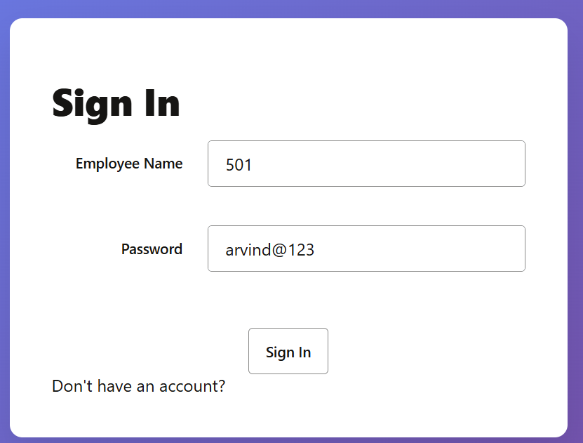
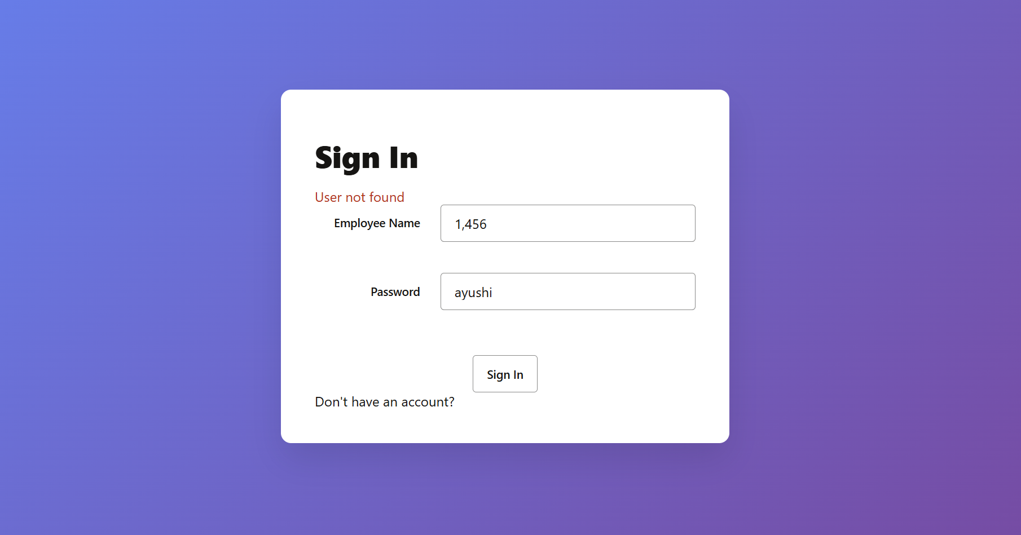
Screenshots of Implementation
Front End (Login Page) -

Slide 9
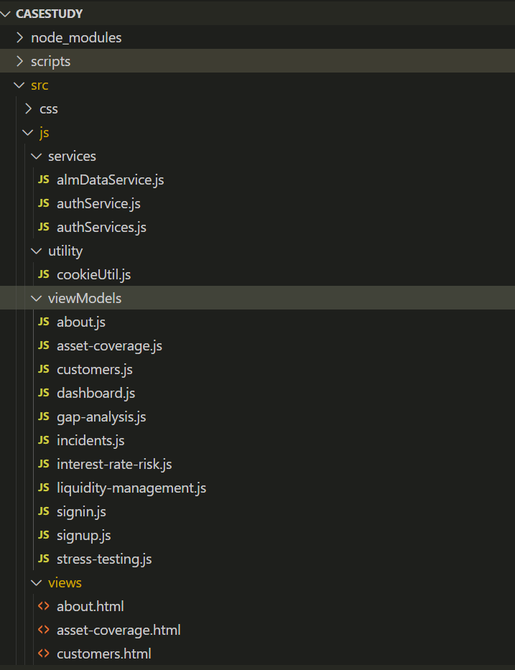
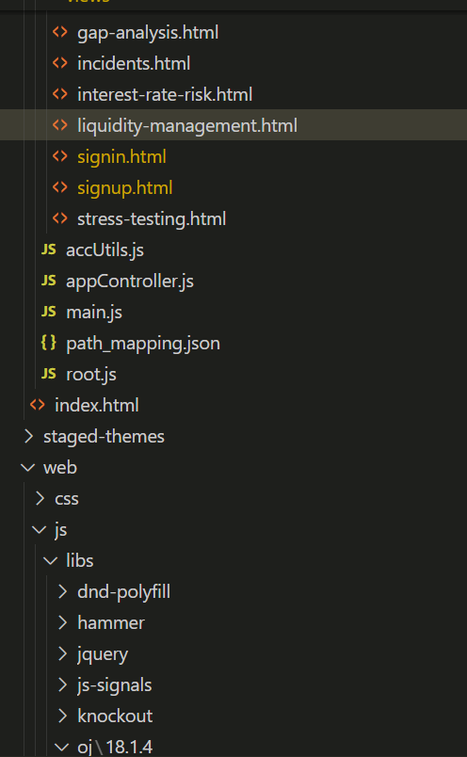
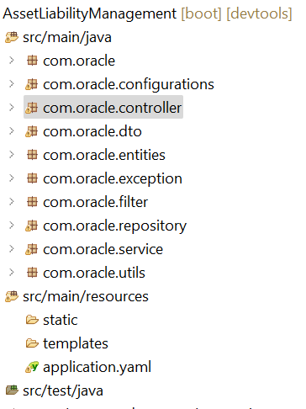
Project Structure
Front End -
Back End -

Slide 10
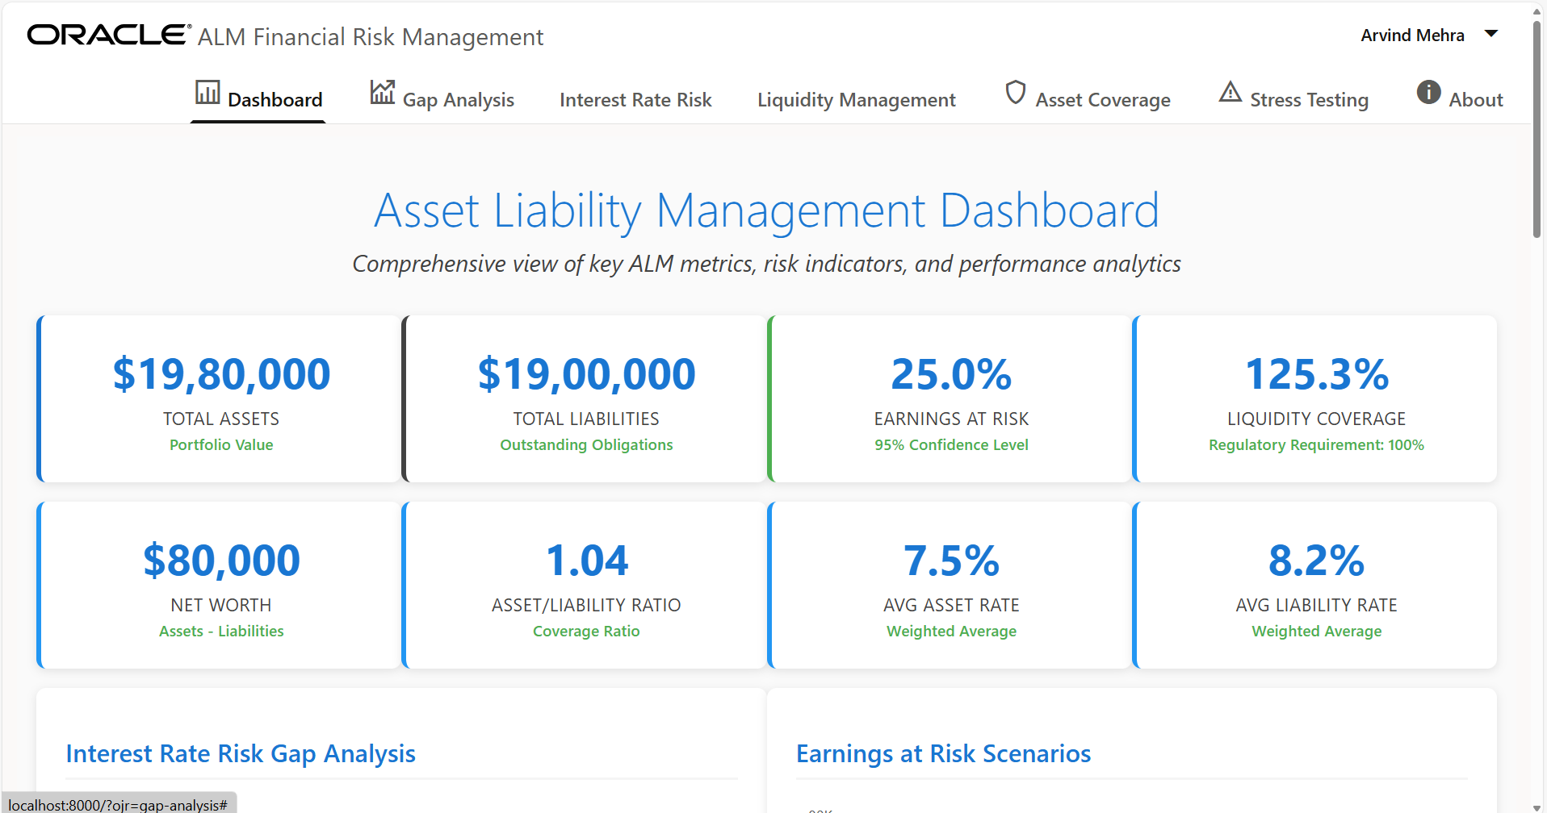
DashBoard

Slide 11
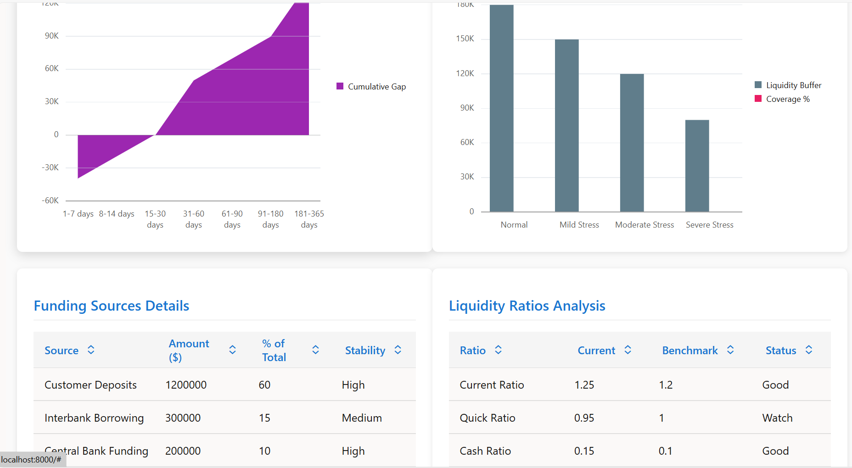
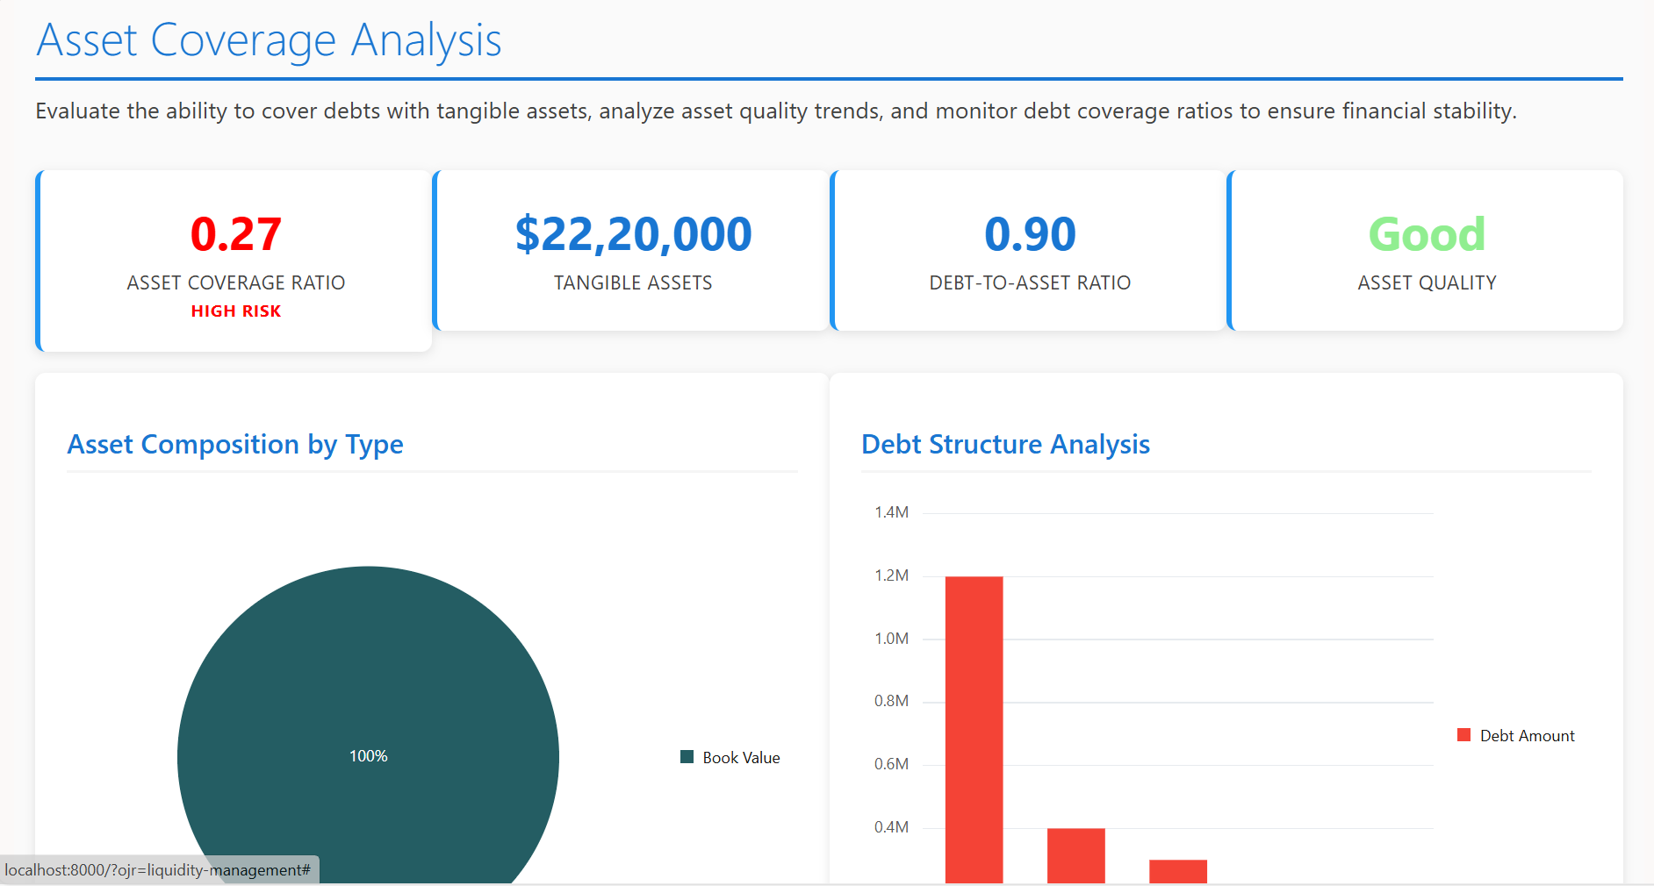
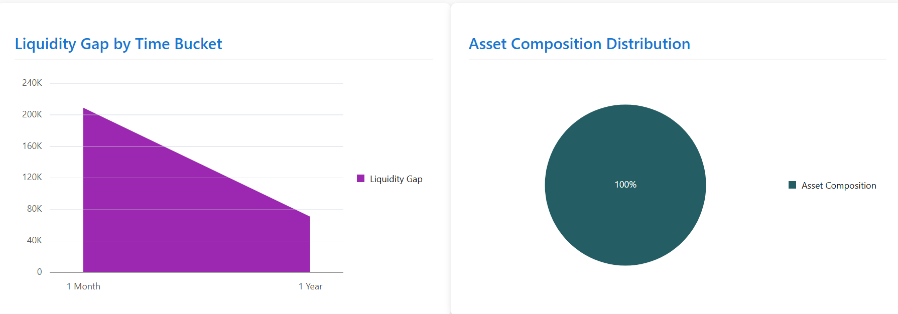
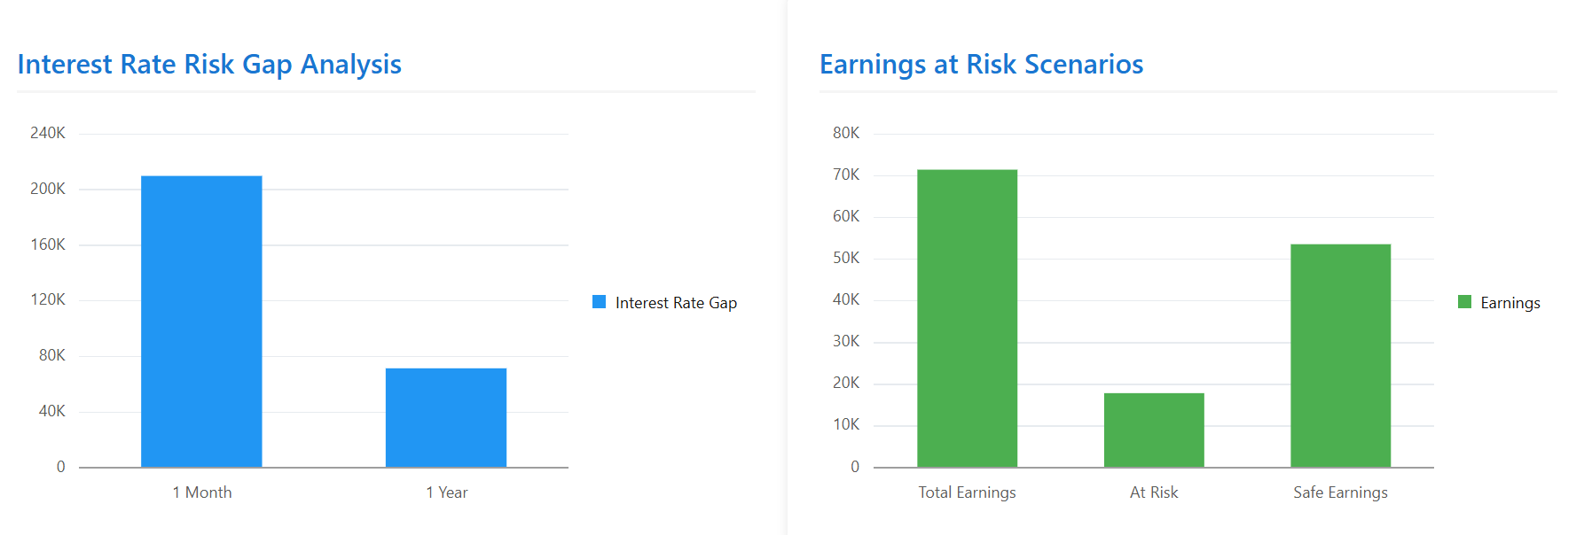
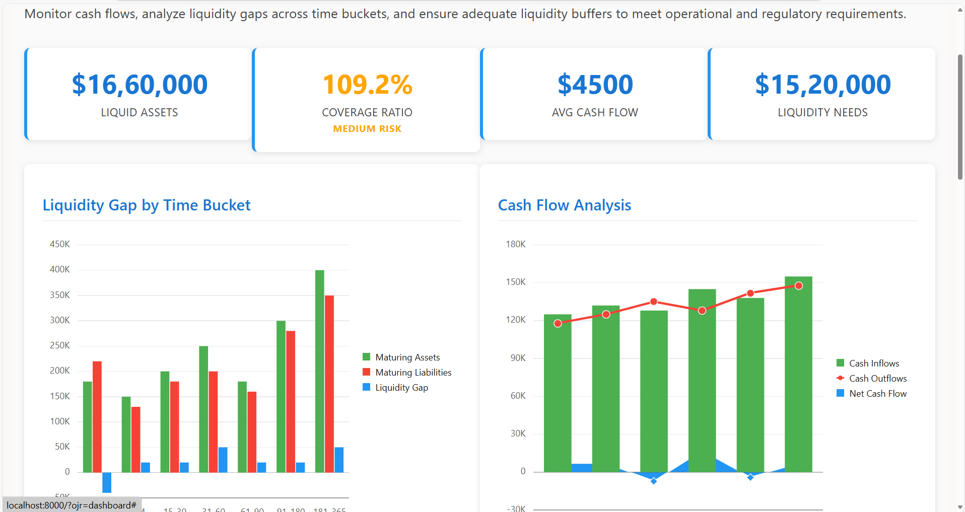
Dashboard

Slide 12
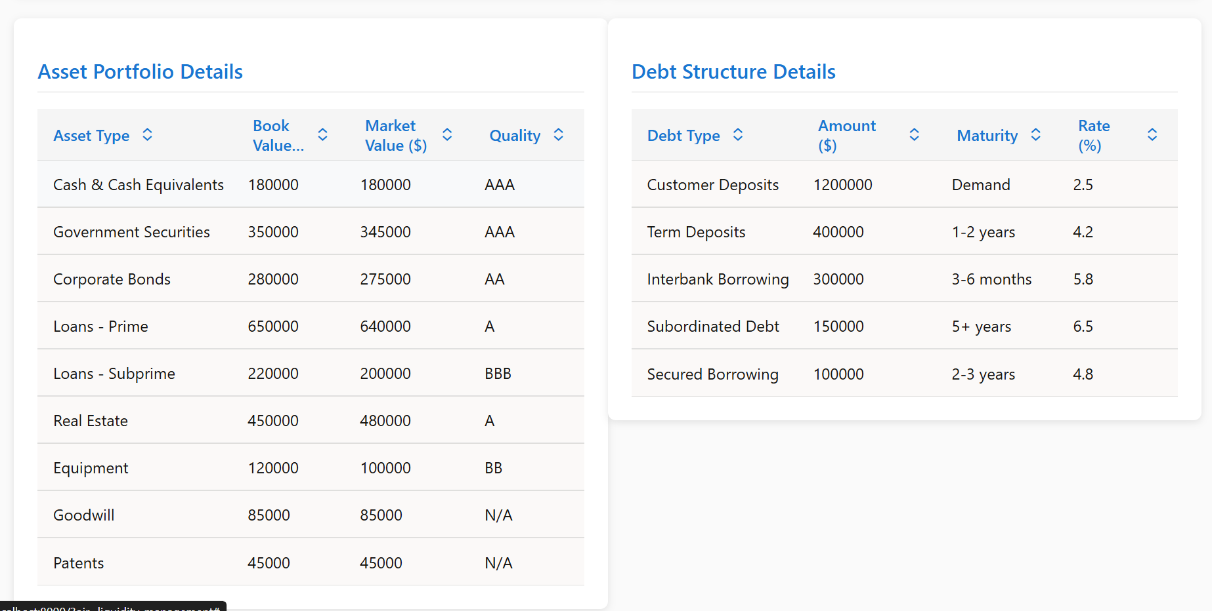
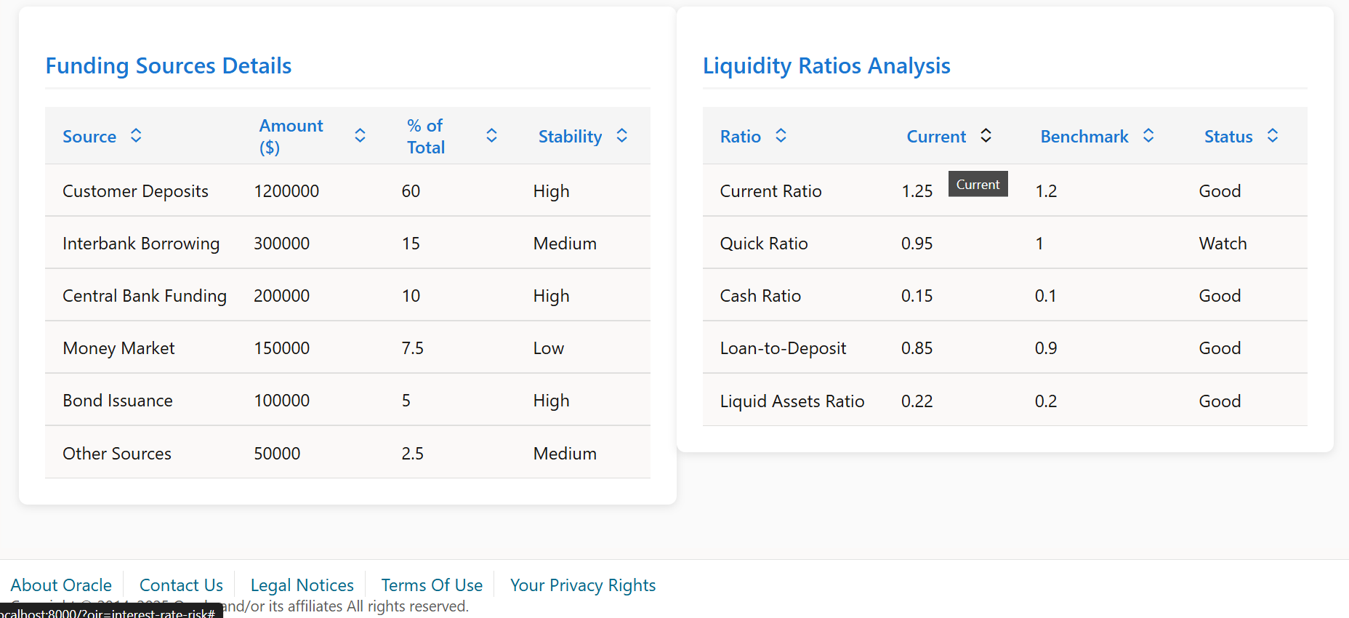
Data Analytics for useful Insights

Slide 13
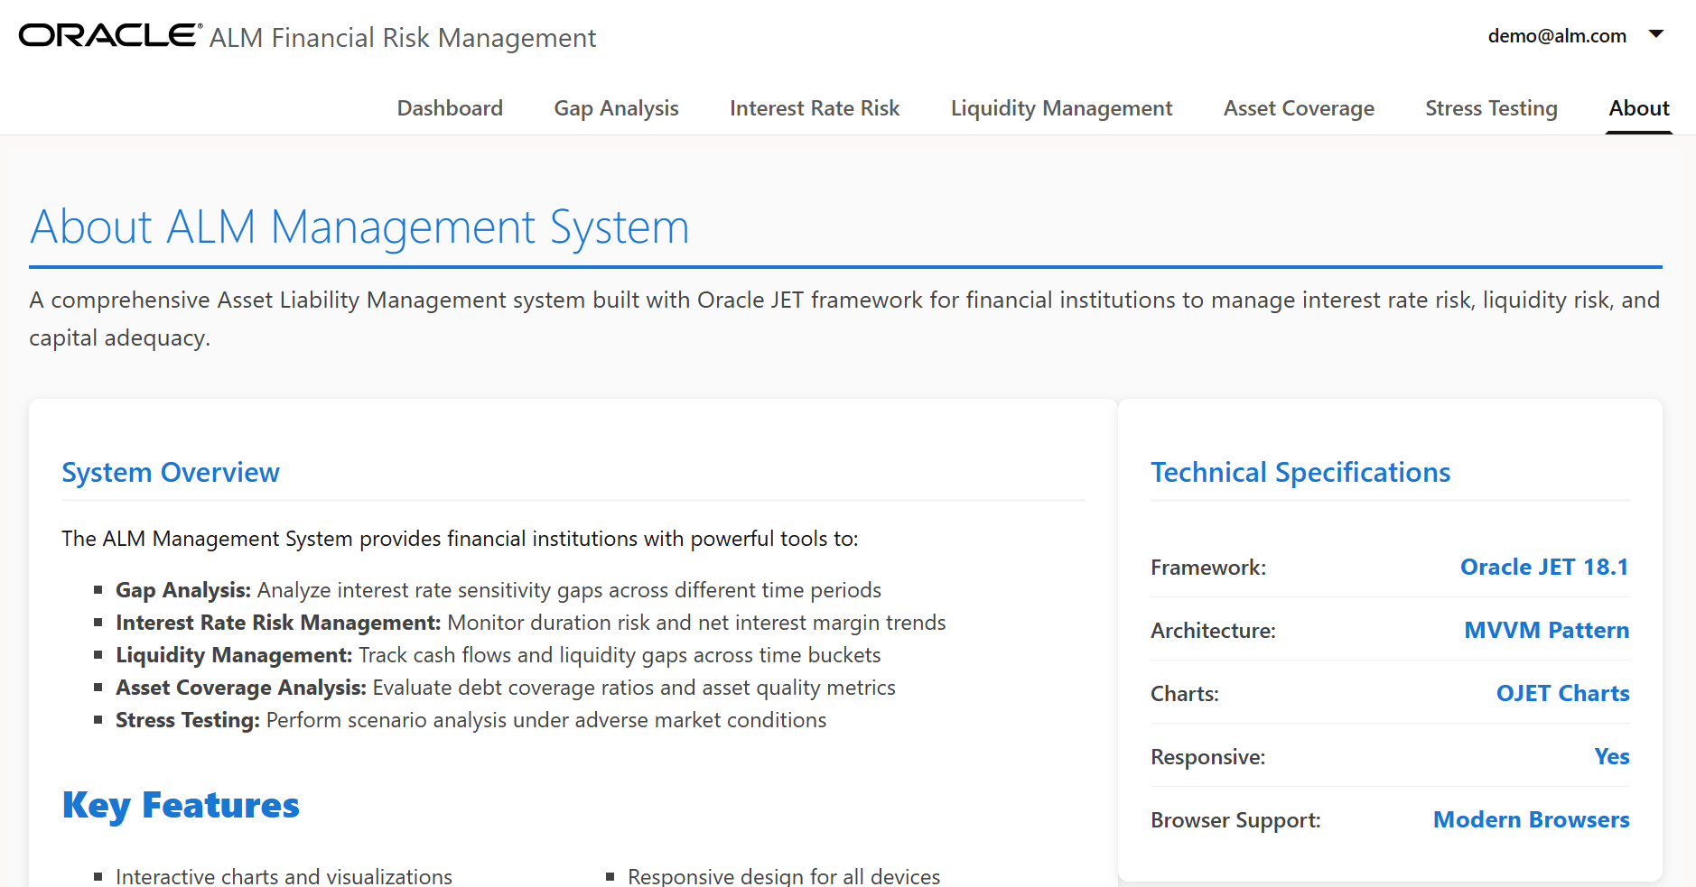
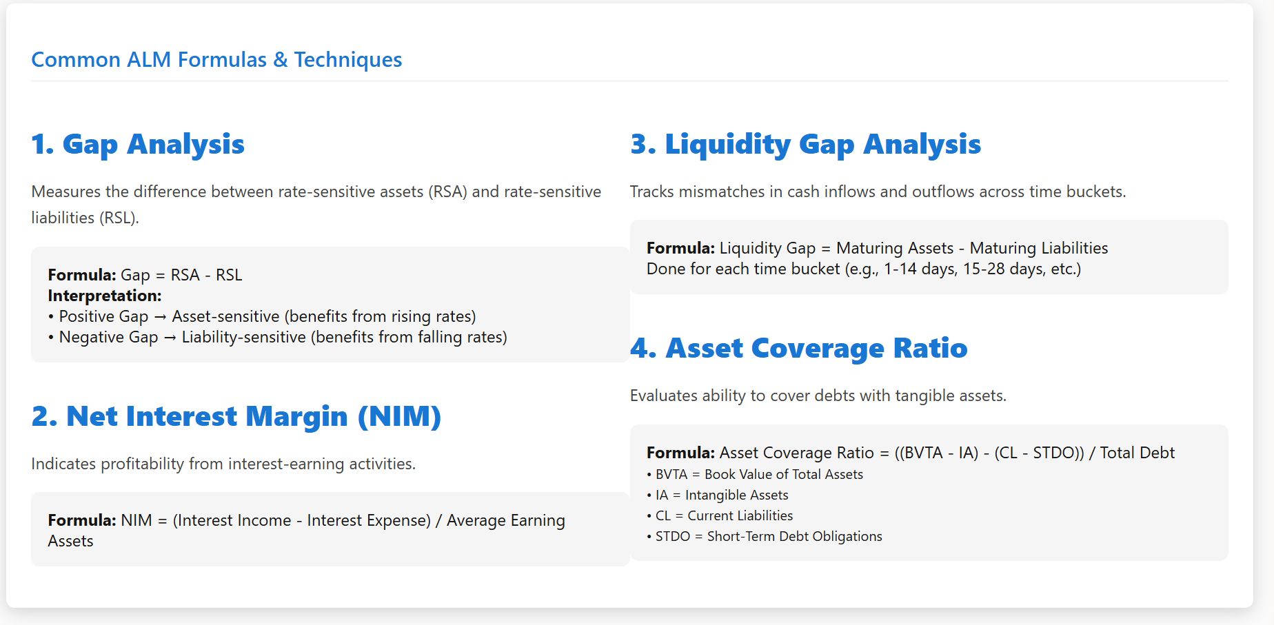
About

Slide 14
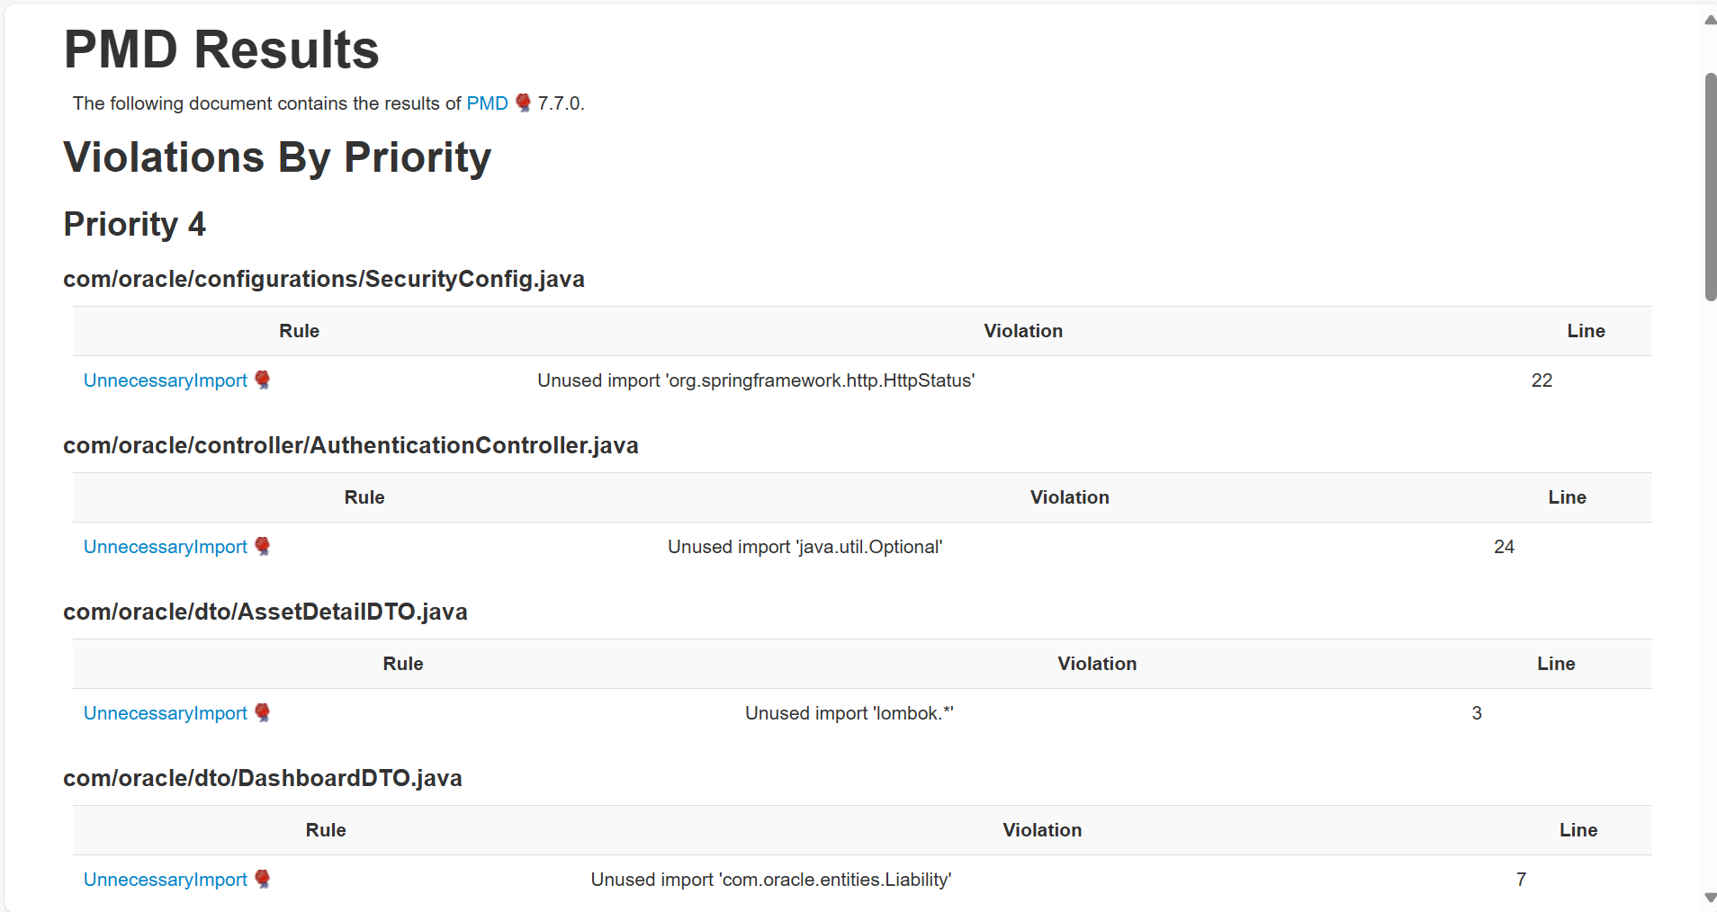
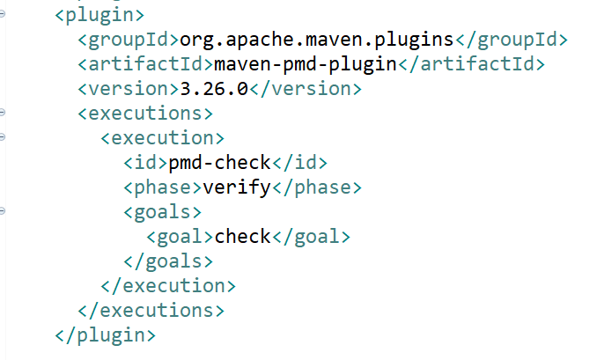
Plugins
PMD -

Slide 15
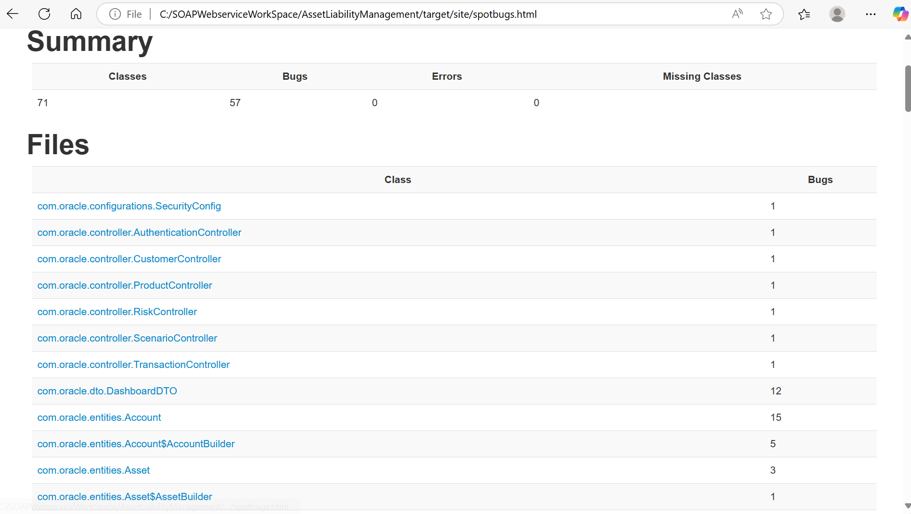
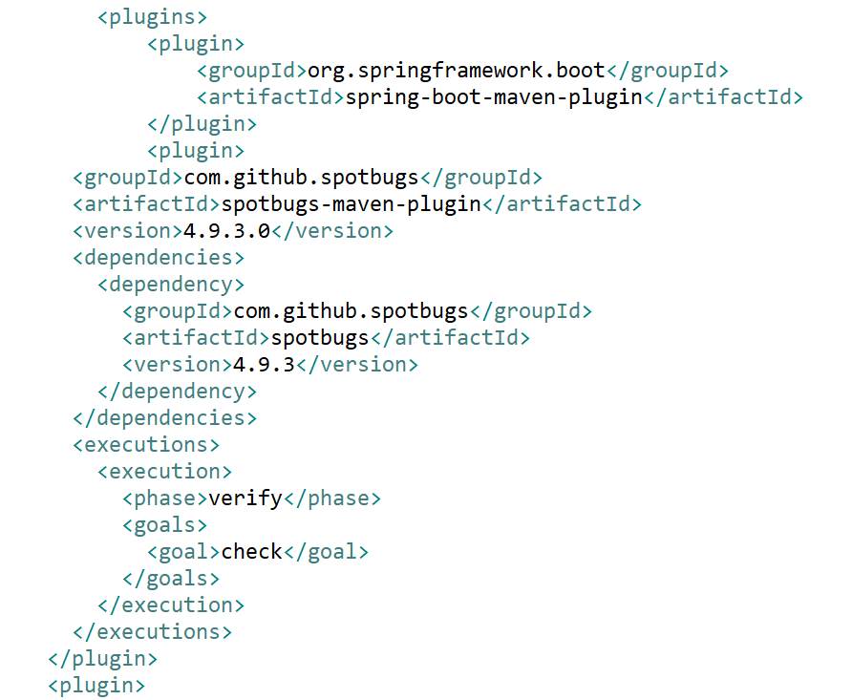
Spot Bug Report -

Slide 16
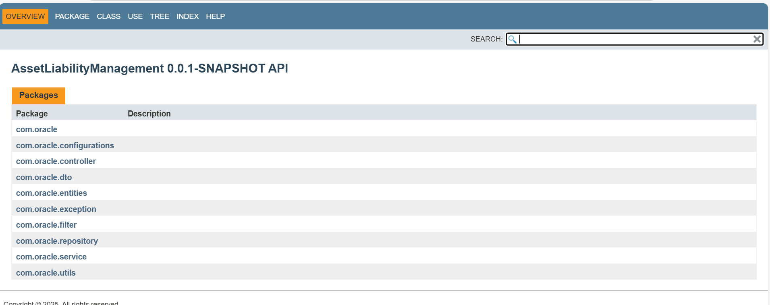
JavaDoc -

Slide 17
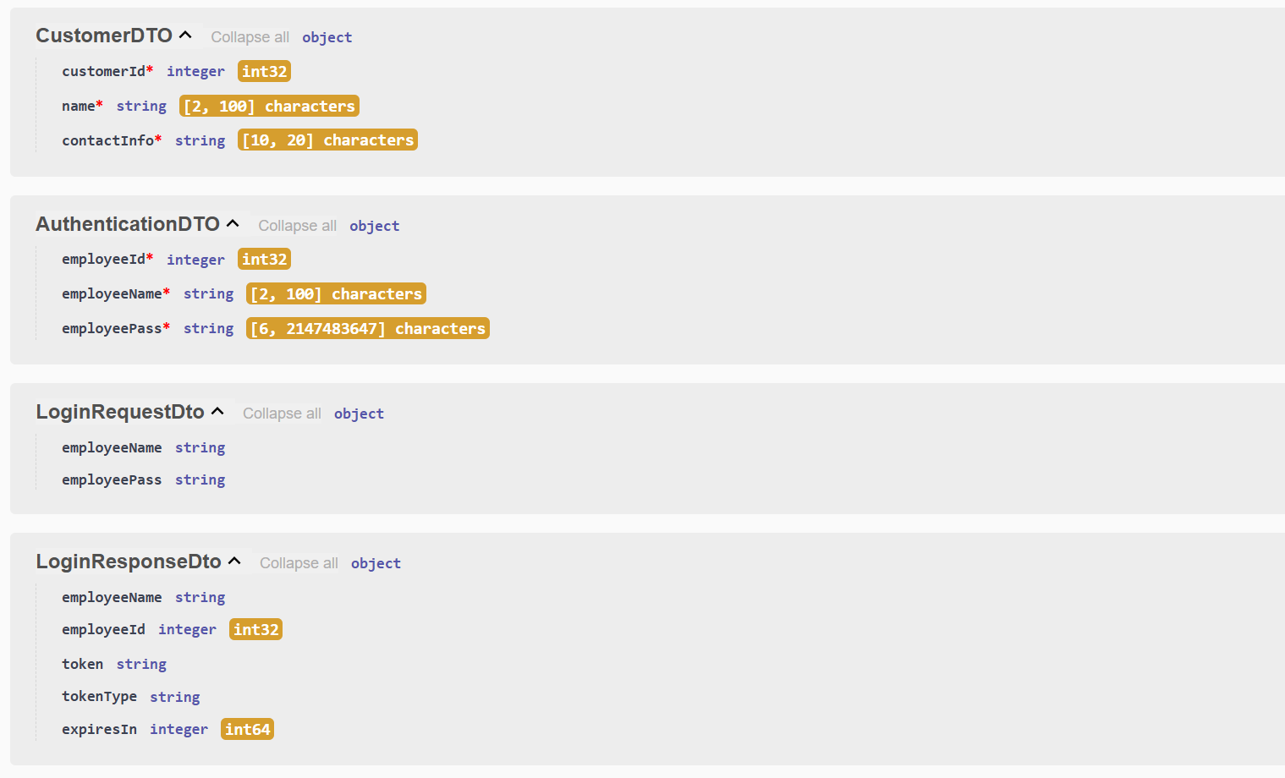
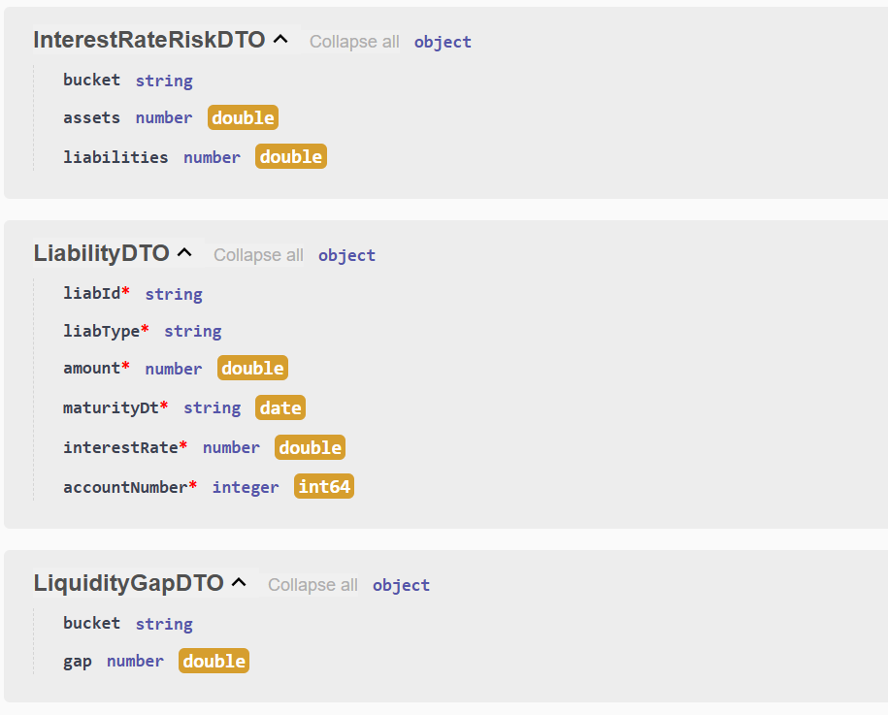
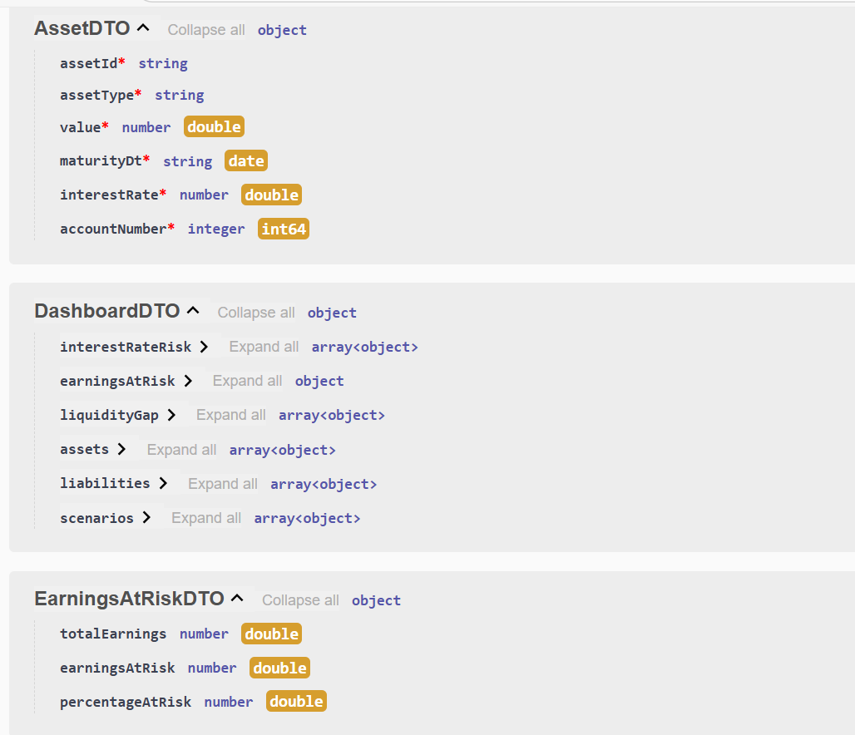
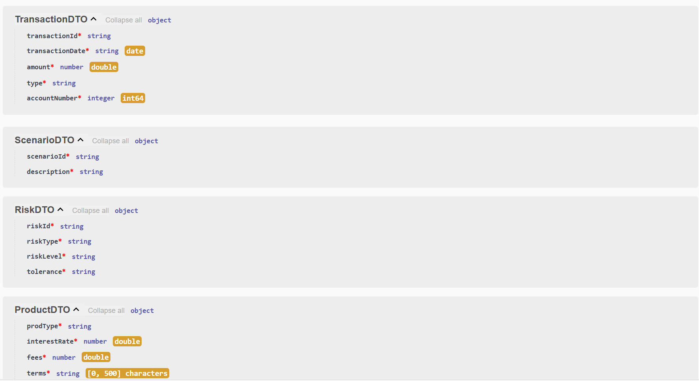
Schemas

Slide 18
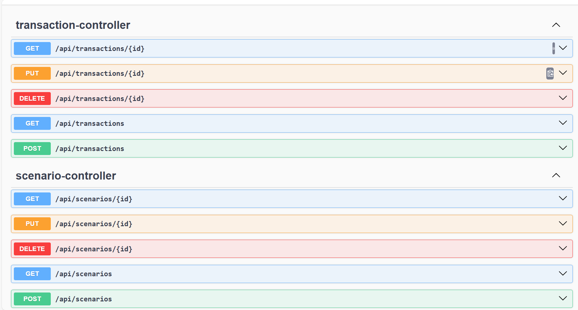
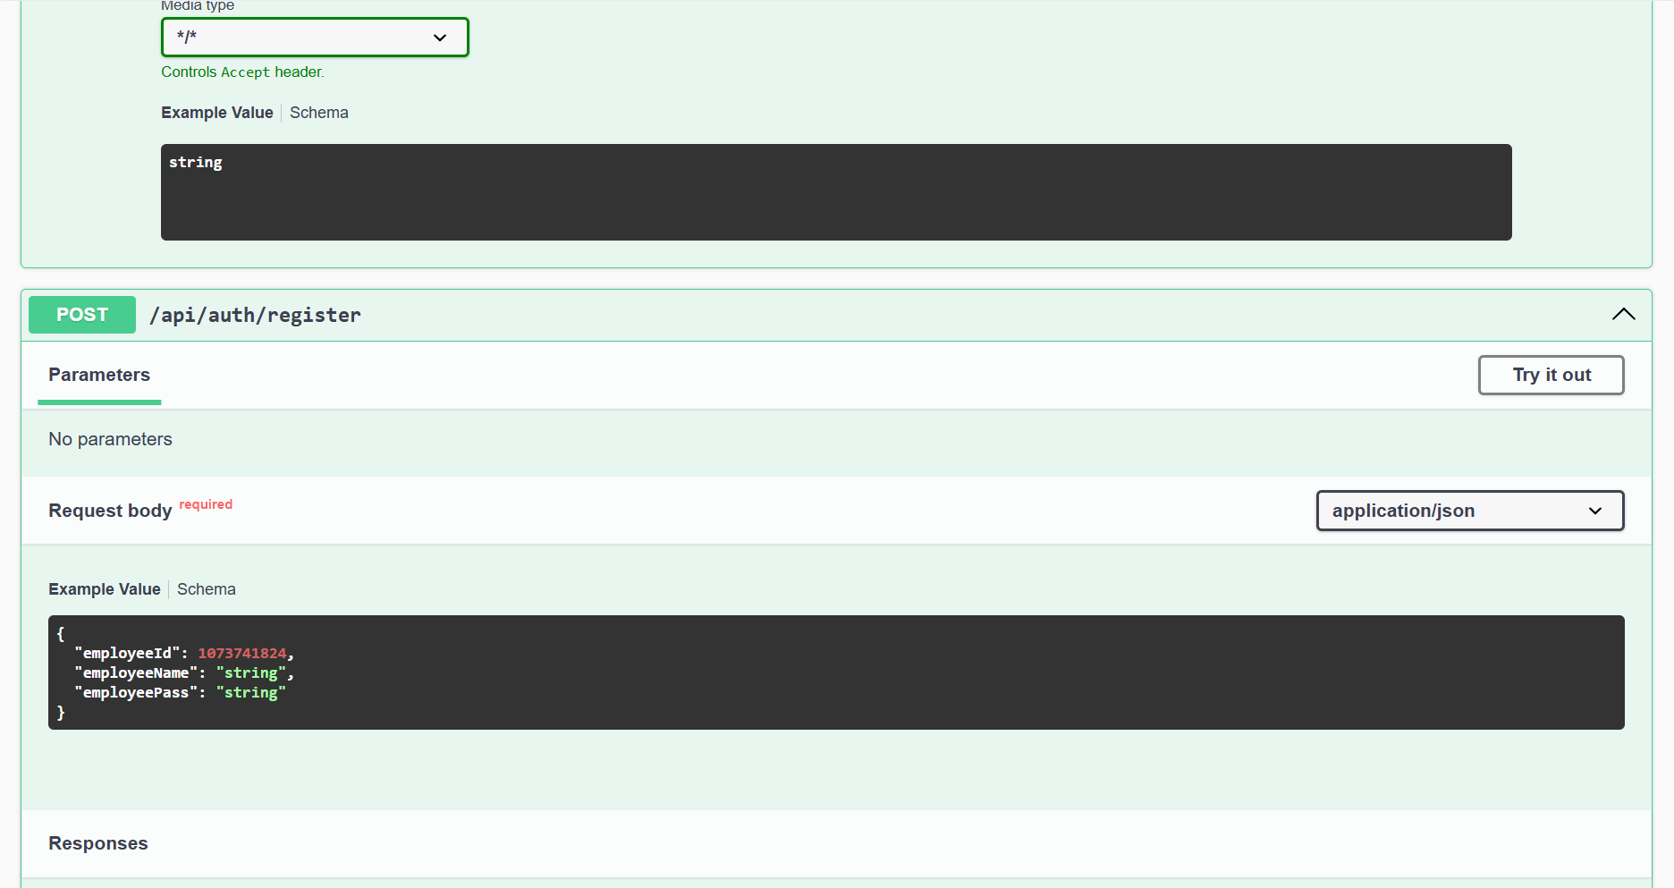
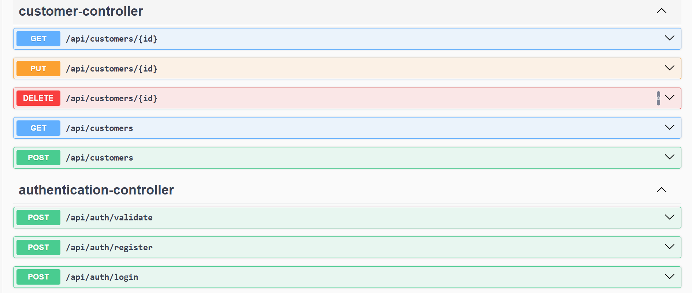
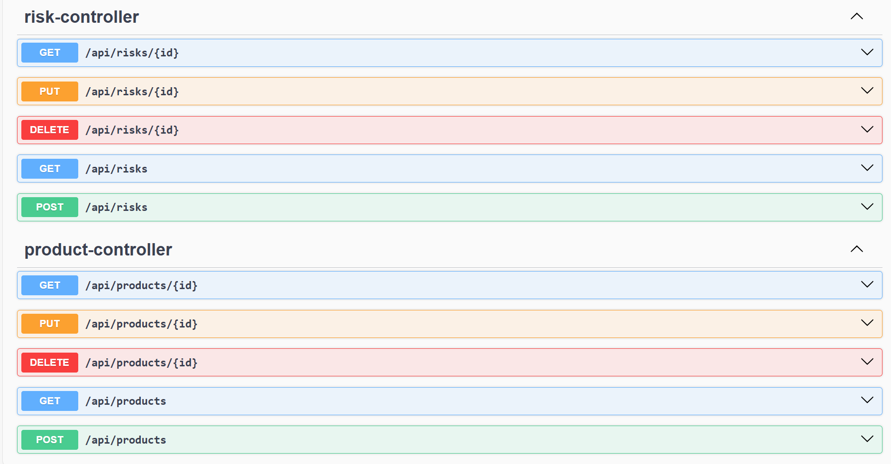
Rest API testing and OpenAPI specification based documentation using Swagger

Slide 19
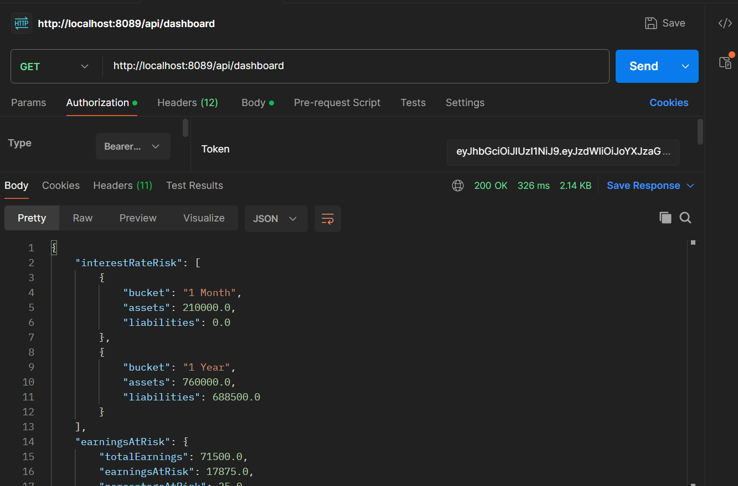
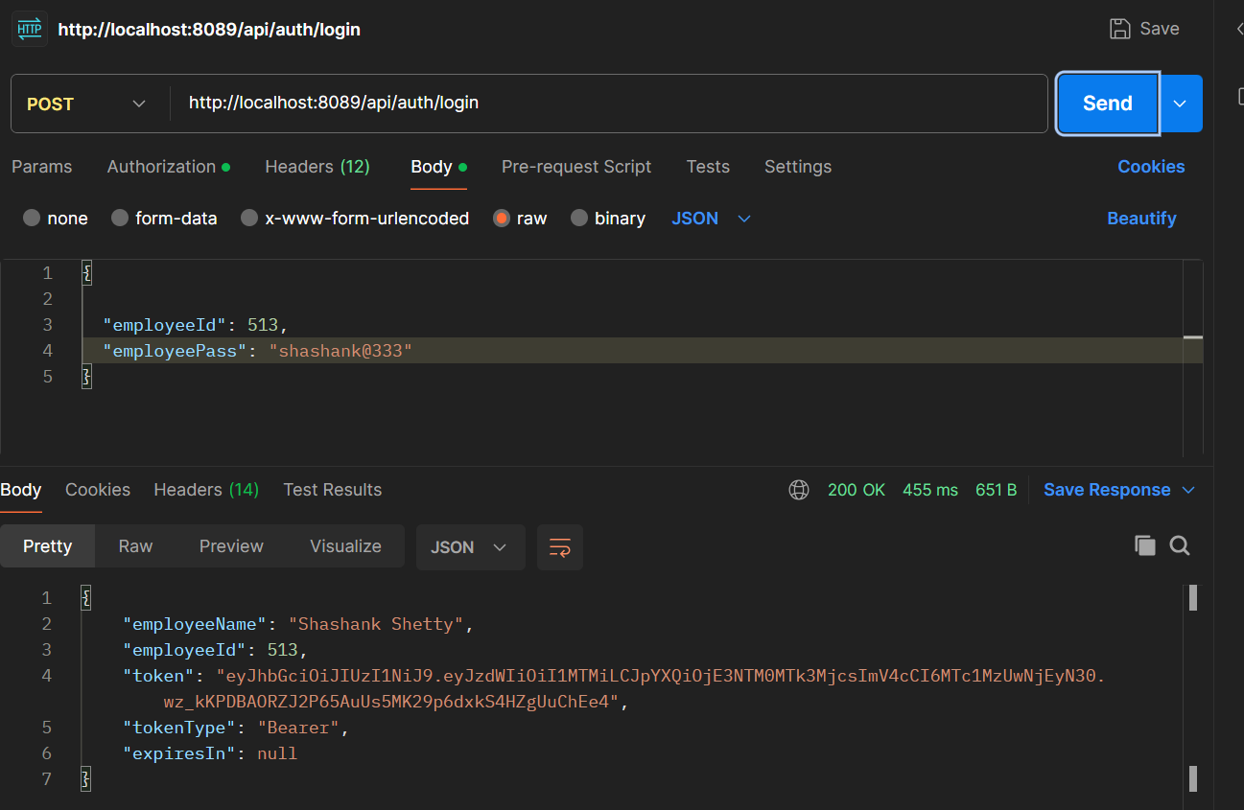
Testing REST Endpoints using Postman
DashBoard -
Login -

Slide 20
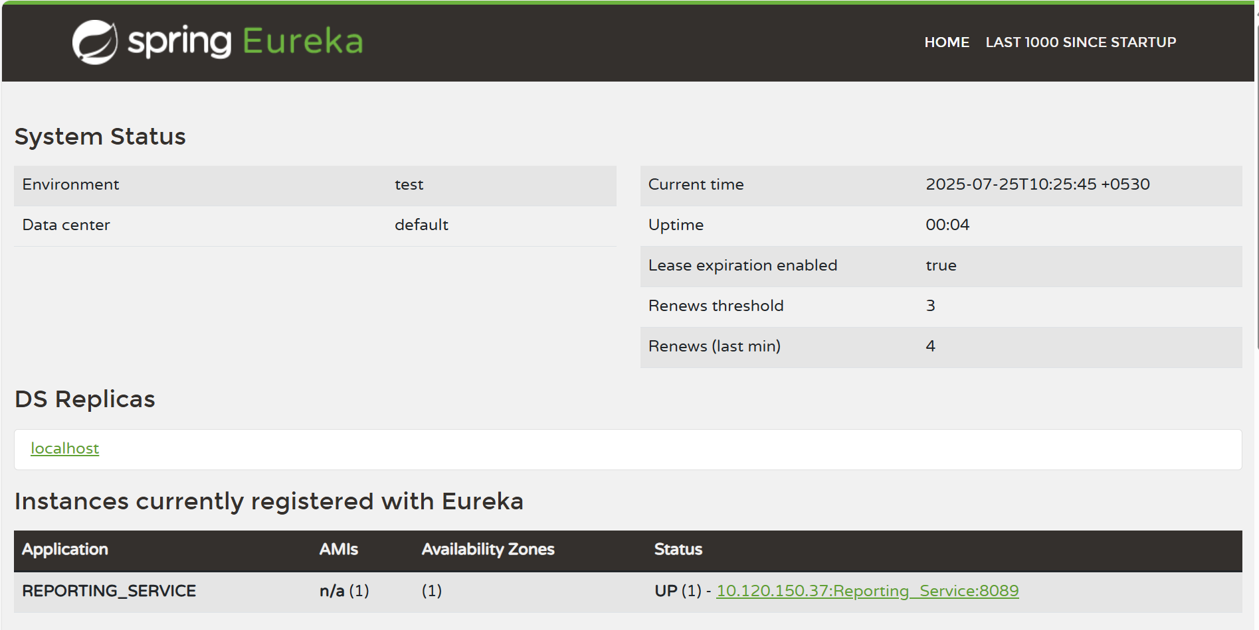
Service Discovery Using Eureka Server

Slide 21
Challenges Faced
Data Overload: We navigated vast amounts of financial data, dealing with different formats, sources, and update speeds to prevent inconsistencies.
Ensuring Accuracy: We focused heavily on validating all financial calculations (like depreciation, net asset value, interest) and ensuring precise data inputs everywhere to avoid costly errors.
Live Updates: Building real-time dashboards and reports required super-efficient backend logic and optimized queries to deliver instant insights.

Slide 22
Learnings & Takeaways
Financial Workflows : Gained in-depth knowledge of how financial institutions manage assets, liabilities, risks, and compliance at an enterprise level.
Backend Development (Spring Boot) : Skilled in building RESTful APIs with Spring Boot, implementing layered architecture, and handling data with JPA with Eclipse Link.
Frontend Integration (Oracle JET) : Learned to build enterprise-level UIs with OJET, using its components, binding data with Knockout.js, and integrating with backend APIs.

Slide 23

Thank you!

